Slide 1
SEC555
Presentation based on SEC555: SIEM with Tactical Analytics
Alert Investigations in the SOC – Building Your Workflow
Justin Henderson (GSE # 108) and John Hubbard
@SecurityMapper @sechubb

Slide 2


About Us
Justin Henderson
SEC555 Author / SEC455 and SEC530 Co-Author
GSE #108 / Cyber Guardian Blue + Red / 60 certs
Owner of H & A Security Solutions
Twitter: @SecurityMapper
John Hubbard
SEC555 / SEC511 Instructor
SEC450 Author / SEC455 Co-author
SOC Lead, GMON | GREM | GPEN
Twitter: @SecHubb

Slide 3
Welcome!
A copy of this talk is available at: https://github.com/HASecuritySolutions/presentations
More free stuff: https://github.com/HASecuritySolutions
Workflow
System

Slide 4
Alert Investigations
Emphasis for this presentation is alert investigations and case management. We will be discussing:
Where should alerts be stored for triage?
Why centralizing alerts can be a bad thing?
How can the investigation process be improved?
Fact or myth: Analysis via a single pane of glass is best
- You decide at the end of this presentation

Slide 5
Alert Collection
Some logs represent alerts!
Potentially actionable data, must decide where do these go:
Logs only? IDS console? SIEM? Direct to ticketing?
12/12-06:22:52.879193 [**] [1:2014126:1] ET CURRENT_EVENTS DRIVEBY Blackhole Likely Flash Exploit Request /field.swf [**] [Classification: A Network Trojan was Detected] [Priority: 1] {TCP} 192.168.45.10:1046 -> 78.46.173.138:80
Oct 30 09:50:48 1,2012/10/30 09:50:48,01606001116,THREAT,url,1,2012/04/10 04:38:23,192.168.0.2,204.232.231.46,0.0.0.0,0.0.0.0,rule1,crusher,,web-browsing,vsys1,trust,untrust,ethernet1/2,ethernet1/1,forwardAll,2012/04/10 04:38:24,12783,1,59024,80,0,0,0x200000,tcp,block-url,"onlinebrandsecuritys.com/install/ws.zip",(9999),malware-sites,informational,client-to-server,0,0x0,192.168.0.0-192.168.255.255,United States,0,

Slide 6
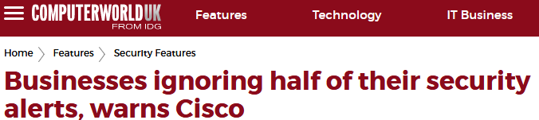
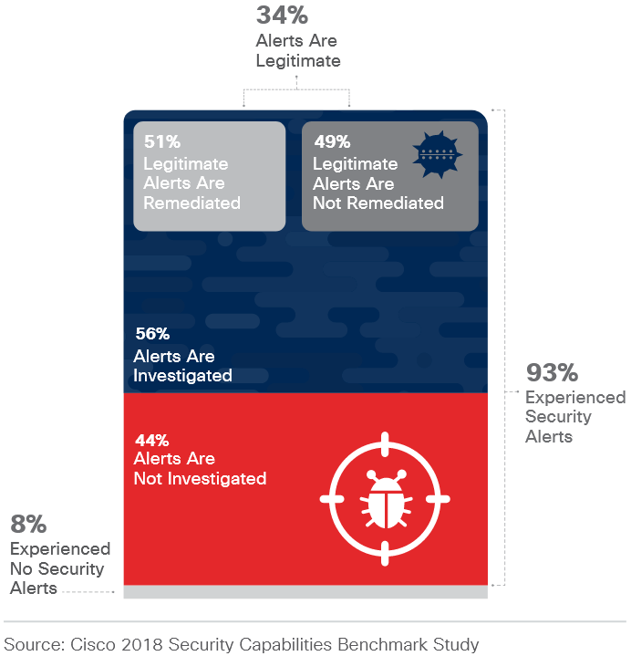
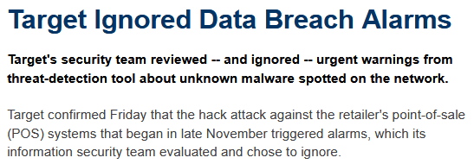
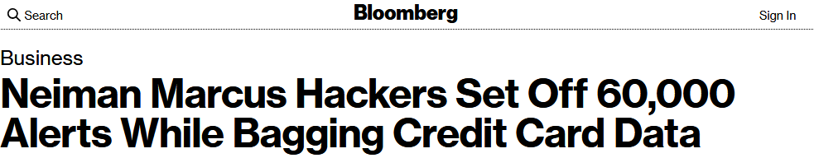
The Problem With Alerting: Volume

Slide 7
Signature Anomalies by Tool
Signature-Centric: IDS/IPS, Firewall, AV, WAF
Primarily use signatures of known bad traffic and files
If high-fidelity, might send straight to incident ticket
Anomaly-centric: User Behavior Mon., ILP, some IDS
UBA uses data science / heuristics to find outliers
IDS signatures can be anomaly centric (VNC seen, EXE download)
Anomaly + domain expertise and context = malicious activity alert

Slide 8
Anomalies vs. Signatures Illustrated
Maliciousness
Evil Both
Neither Anomalous
Anomaly-based
Alerts
True Positive
False Positive
Anomaly Score

Slide 9
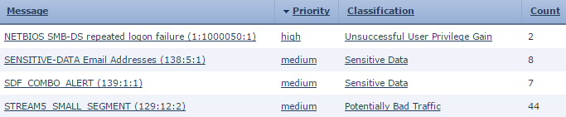
Alert Data
Alerts by themselves can be bland and unforgiving
Repeat logon failure … ok that is probably bad
Sensitive email addresses, that seems bad
More context and data is necessary

Slide 10

Silo Alert Management
Goal is to add efficiency and detection for analysts
Often involves centralizing alerts
Prior to this, each “alert" was monitored separately
Handling alerts per product results in:
Inefficiency in handling
Lack of correlating evidence
Territorial issues when tagging off or requesting data
Missing alerts (firewall team may not monitor alerts)

Slide 11
Point Product Analysis
Vendor point products have pre-built consoles
Allow pre-canned analysis/workflow for investigations
PROs
Designed with specific alert data in mind
Includes extra features specific to the vendor offering
CONs
Not flexible and minimal customization
Does not integrate with other data and information

Slide 12
Snort Alert
March 3 19:40:32 sensor1 snort: [1:560:6] POLICY VNC server response [Classification: Misc activity] [Priority: 3]: {TCP} 10.5.55.7:5904 -> 10.5.55.8:53852
Format is concise and easy to parse
Yet limited on information presented
What sensor interface did this come from?
What about packet data?

Slide 13
Standard Fields vs. Extra Fields
Sensor name
Signature ID
Generator ID
Revision ID
Alert name
Classification
Priority
Protocol
Source IP
Source port
Destination IP
Destination port
Flow ID
Sensor interface
Packet payload
VLAN #
Action taken
HTTP content type
HTTP method
HTTP User Agent
HTTP status
Other HTTP fields
TLS fingerprint
TLS issuer
TLS expiration info
Other TLS fields
And many others …

Slide 14
SIEM Analysis
Sending data to SIEM provides a lot of context
PROs
Can cross-correlate with other data (efficiency increase)
Lots of customization options (prioritize, enrich, etc.)
Can build analysis/workflows across multiple data sets
CONs
Does not integrate or use all of the vendor feature sets
Requires labor for tuning and maintenance

Slide 15
Centralizing Alert Investigations
Initial Results
Results with Planning
Centralization of alerts initially is a net loss
No dashboards
No workflows
Loss of vendor specific “extras” and “add-ons”
Alert may loose context
- Net Loss
SIEM + Case management need labor to have net gain
Build outcome driven dashboards
Design playbooks
Integrate with external tools
Enrich alerts for context
+ Net Gain

Slide 16
Enrich for Analysis
Alerts need optimized for human consumption and analysis
Consider simple tricks like building an ips array
A couple areas for improvement include:
Geolocation (city + ASN) information
DNS association (rather than IP addresses)
Alert rule and alert metadata
Automatic correlation such as hooks to Sysmon
Asset tags

Slide 17
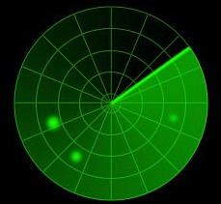
Auto-Categorization
Some rules are expected to be noisy
ET SCAN Potential SSH Scan from external
Question is, do you care?¹
An analyst should not be investigating every port scan
Auto categorizing these alerts can be useful
Can be used in management reports
Can also be applied to specific policy violation alerts
Specifically, those over which you have no authority

Slide 18










Moving Alerts to Case Management
Where to place and investigate alerts?
SIEM
Workflow system
Recommendation - Lean towards systems that support automation and custom flows

Slide 19

Alert Log Flow Illustrated
Alerts
IDS
Console
SIEM
Triage
Triage
Incident Management System
Accepted?

Slide 20
Alert Log Flow Options
Consider your options, combine if needed:
Send alerts to SIEM, create ticket from SIEM
One location to maintain incident creation events
Allows additional enrichment and correlation
Useful for dashboards, reporting for false positive reduction
Send alerts directly to ticketing system
For high-fidelity alerts
May or may not interface directly, formats may differ, two management locations
Send alerts to preliminary queue for initial processing
For low-fidelity alerts/anomalies, false positive reduction early in process
Another queue to deal with

Slide 21
Incident Management Systems (IMS)
Options:
Traditional ticketing solutions
SIEM built-in solutions
Security-tailored ticketing
Commercial, security-oriented:
Resilient
Archer
ServiceNow
CyberCPR
Traditional Ticketing:
BMC Remedy
RT
Redmine
FOSS, security-oriented:
TheHive
RTIR
FIR
OTRS

Slide 22

TheHive – Incident Management System
Outstanding free IMS
Incidents are organized and assigned by case
Cases follow steps in a pre-made case template (playbooks)
Cases have tasks that to be completed
Tasks have associated worklogs
Cases can have observables assigned to them
Observables can be enriched by analyzers enabled in Cortex engine

Slide 23
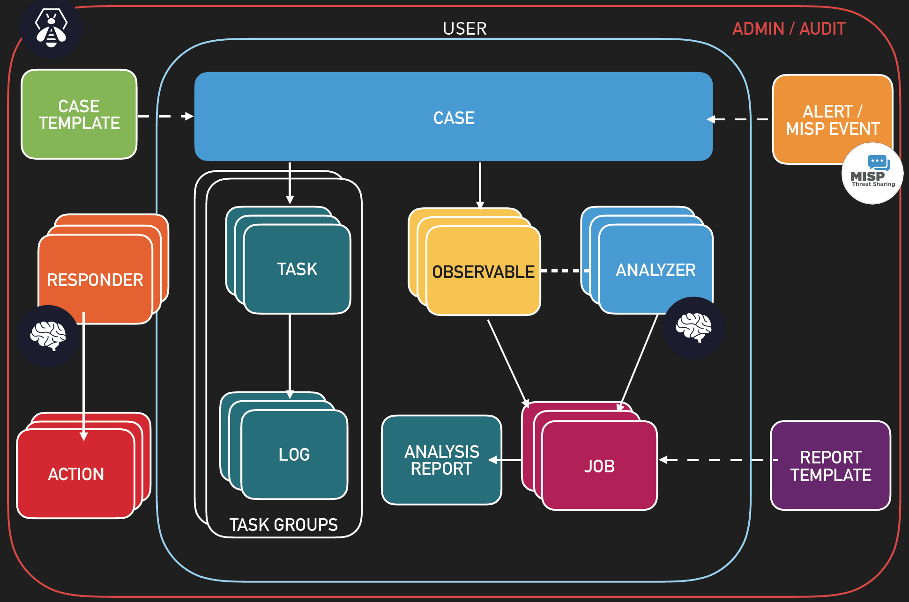
TheHive – Workflow

Slide 24

TheHive - Automatic Case Creation with Context
Events collected SIEM, items of interest become alerts
Alerts sent to TheHive for triage
New case created for all accepted alerts
Case is populated with field from alert:
Parses fields from alert
IP addresses, domains, usernames, hostnames, etc.
Pulls in additional info if available
Tasks created from designated case template (playbook)

Slide 25

TheHive - Working a Case
Assigned tasks show up in "My tasks"
Tasks can be part of task groups
Investigation Questions – aligned with "kill chain" or other
Delivery - "How many malicious emails were delivered? Where did it come from?"
Exploit/Install - "What exploit does the file use? What files does it drop?"
C2 - "What domain is used for command and control?"
Response Actions
"Delete message from all inboxes"
"Reset all compromised passwords"
"Submit sample to anti-virus vendor"
Tasks populated from case template (playbook) must be completed

Slide 26
TheHive – Case and Task Assignment
Both cases and tasks can be assigned to an analyst
Not all IMS's do this – more granular assignment
Enables easier collaborative / tierless SOC operations
New analyst (1) takes easier tasks
Analyst 2 takes complex tasks
Analyst 1 reads 2's work logs
Learns task over time
Better load balancing
Case
Analyst 1
Task 1
Analyst 1
Task 3
Analyst 1
Task 4
Analyst 1
Task 5
Analyst 1
Task 6
Analyst 2
Task 2
Analyst 2

Slide 27
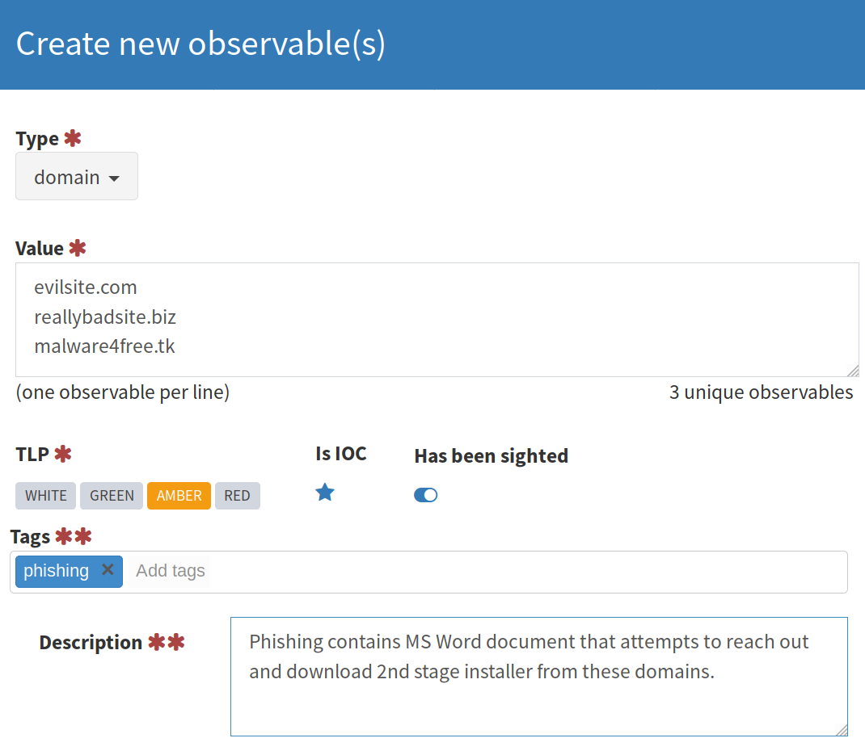
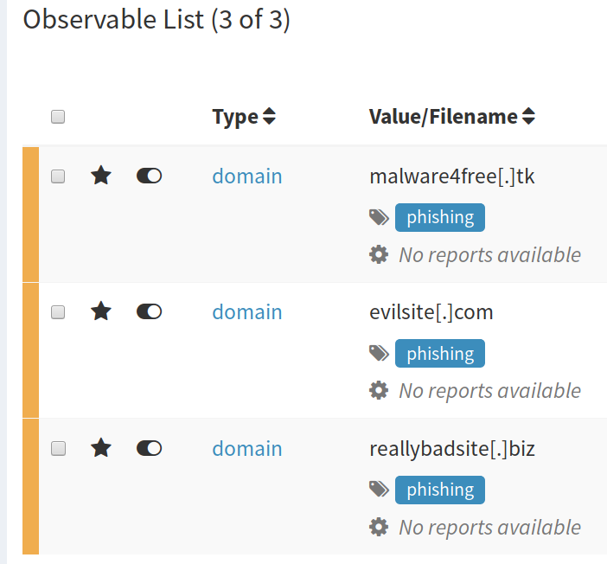
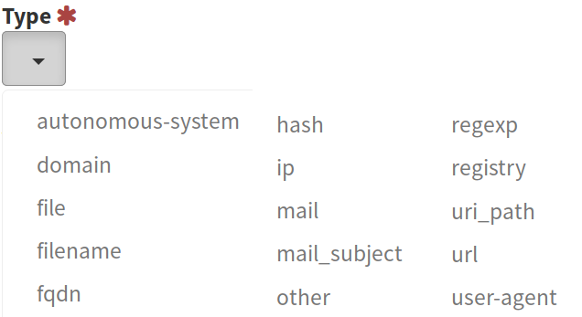
Observables

Slide 28

Cortex
Automated analysis and enrichment engine
Comes with TheHive and is tightly integrated
Has it's own setup and users
Uses API key to link to TheHive
Analyzers reduce repetitive enrichment actions for indicators
VirusTotal, Passive DNS lookups, etc.
Responders provide automated response actions
New functionality more directly aimed at SOAR

Slide 29


Cortex Automated Analysis
Observable entered
evilsite.com
VirusTotal URL
Analyzer
Is evilsite.com bad?
API
1
2
Stored in case
Phishing link!
Yes, known phishing
4
3
4
Evilsite.com = phishing link!

Slide 30
MISP
Malware Information Sharing Platform
A free, open-source analyst favorite
Capability of high-volume indicator storage
Great web UI and REST API interface
Classification and sharing functionality
Flexible indicator storage
Easy import/export
Integrates with TheHive for automated storage/analysis

Slide 31
MISP Workflow Overview
Analyst Usage:
Analyst creates new event
All indicators, links, files, and notes are added as attributes
Tags and other classifications (galaxies) applied
Event reviewed, published to other organizations (if desired)
Automated usage through SOC tools:
SIEM, SOAR, IMS use API to look up or push attributes to event
Subscribed feeds automatically download external event data
Anytime any of them are seen in live traffic = Alert

Slide 32

MISP Events Illustrated
Event 1
Attributes:
source_ip: 12.34.56.78
domain: evilsite.com
filename: shipment_received.xls
hash: 298a736489bdfe869
Classifications:
Tags: kill-chain:delivery, trojan
Galaxies: APT99
Event 2
Attributes:
source_ip: 100.200.55.66
domain: goooogle.com
filename: invoice.doc
hash: 298a736489bdfe869
Classifications:
Tags: kill-chain:delivery

Slide 33

MISP Sharing Illustrated
Org-1 MISP
Org-2 MISP
Events
Events
Shared Events

Slide 34


Putting It All Together
Logs & alerts
Alert data to new cases
Events /
IOCs
Automation Actions
Atomic Indicators
API
Enrich Events

Slide 35
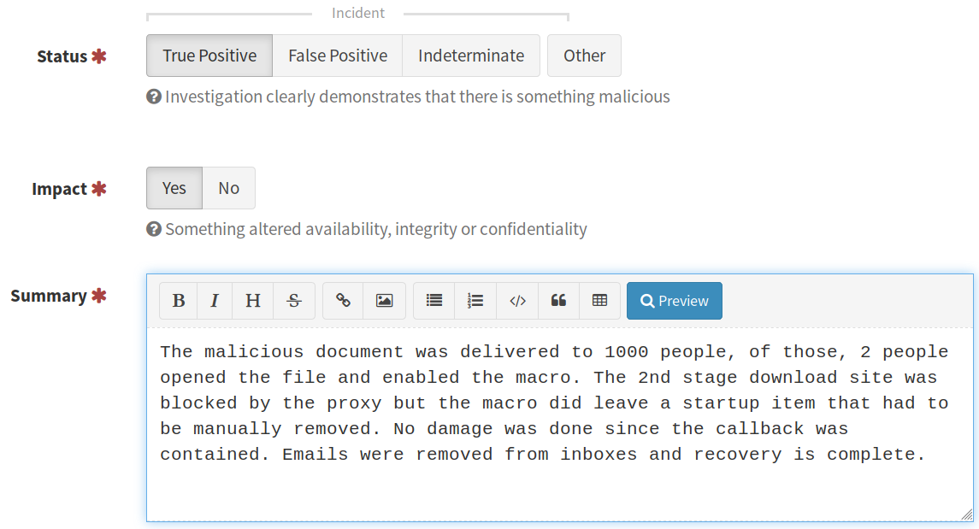
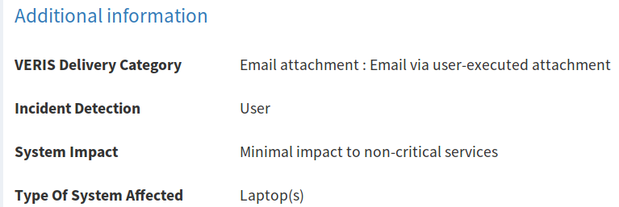
Case Closure
Once tasks are completed, cases can be classified and closed

Slide 36
Closed Case Classification
Some metrics worth collecting:
Disposition: True/false positive, indeterminate
Incident Type: Malware, Hacking, Insider Threat, etc.
Time: To detect (dwell), assign, contain, remediate
Initial Detection Source: FW, AV, IDS, external, etc.
Device Types Affected: User Laptop, Server, ICS, etc.
Attribution/Motivation: Group name/type, objective
Summary: Bullet point style executive summary

Slide 37
Knowledge Base
Closed tickets act as a simple knowledge base
Better if full knowledge base functionality supported
Helps solve specific questions during analysis:
How to investigate specific types of alerts
What logs to correlate with
What systems would matter giving the alert
Why an alert in some cases may be a false positive
May also help to use and/or create playbooks

Slide 38
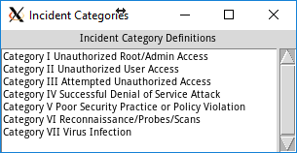
Alert Tuning
Closure codes identify rules with too many false positives
The reverse is also true – Identifies consistent rules
Category VIII – False positive
Rule 1 – 1000 events
86% VIII
12% V
2% Other
vs.
Rule 2 – 10 events
90% I
10% II

Slide 39
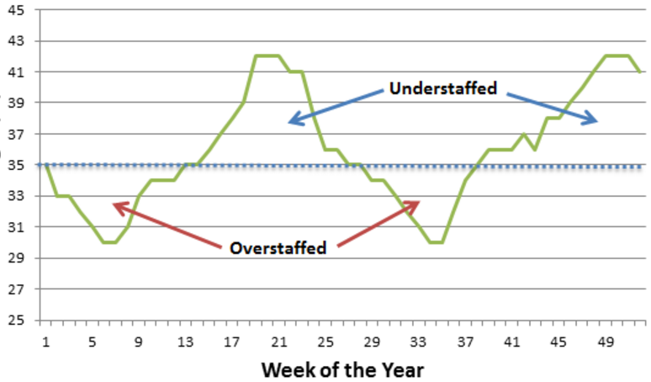
Staff Forecasting
Reporting total alerts over time can forecast staffing needs
Used by management to keep proper staffing levels
Security is often understaffed – forecasting may be ignored
Not enough budget
Executive decision
Lack of qualified candidates
It can be used differently
Which alerts need to be cut to handle current staffing?

Slide 40

SOC Summit

